Slide 1
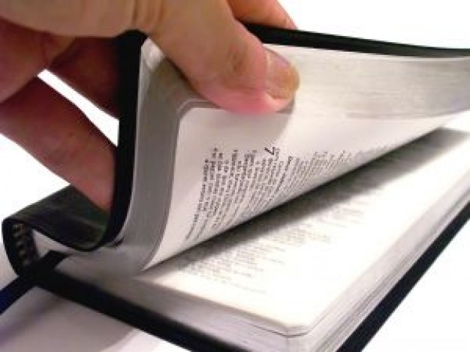
How to prepare an exhortation
exhort… Greek parakaleo .. to call near, console.comfort
choose a subject or theme
prepare well ahead of appointment
study the scriptures you will be using thoroughly
Let all things be done unto edifying.
(1Cor 14:26)
Notes:
Best to base upon scripture. Keep personal biases out. Stories from life experience OK but only to illustrate a scriptural principle in life. Keep ego out of it

Slide 2
Suggestions on the preparation process
make notes on the overall plan of your exhort
the Bible must be pre-eminent in what you say. Balance exposition with exhortation
look for “cross references” and words and phrases which support the scriptures you are using to re-inforce the message
Notes:
Illustrate with baptism of Jesus in Matt 3. Cross reference in Isa 40 of John Baptists commission solves problem of why Jesus is baptised when he has no sins to confess

Slide 3
Some scriptural advice
All scripture is given by inspiration of God, and is profitable for doctrine, for reproof, for correction, for instruction in righteousness: That the man of God may be perfect, throughly furnished unto all good works.
(2Tim 3:16-17)
But he that prophesieth speaketh unto men to edification, and exhortation, and comfort.
(1Cor 14:3)
Notes:
The Corinthian quote is important in view of the disputes and factions which divided the ecclesia. Never exhort to divide always to build

Slide 4
The exhorter’s mind
be aware of our own failings and weaknesses
no place for pride
be aware of the wide variety of needs of the brethren and sisters
they may be carrying burdens of sorrow, worries, sickness, feelings of failure, loss of faith, depression
if there is a need of rebuke or correction do so with meekness and gentleness (read Paul’s letters to Corinth!)
Notes:
The exhorter should be a regular attender and be of good reputation in the meeting see 1 Tim 3. Note no unruly behaviour or drunkenness or immorality

Slide 5
Presentation
approach prayerfully
know your material thoroughly so you can have eye contact with the audience
remember you are exhorting all in the meeting not only the more knowledgeable
relate your subject in some way to the emblems and the work of the Lord
Keep to your allotted time
Notes:
Good knowledge of subject important. Don’t go for novelty but solidarity. If unsure of what you are preparing ask advice of a senior brother

Slide 6
The importance of Bible Study
the Bible is at the centre of our spiritual life
Thy word is a lamp unto my feet, and a light unto my path.
(Psa 119:105)
But he answered and said, It is written, Man shall not live by bread alone, but by every word that proceedeth out of the mouth of God.
(Matt 4:4)
And now, brethren, I commend you to God, and to the word of his grace, which is able to build you up, and to give you an inheritance among all them which are sanctified.
(Acts 20:32)
Notes:
Timothy advised to “Study to shew thyself approved” 2 Tim 2:15 and to be an example 1Tim 4:12,13 Study is essential before you can give a Bible Class

Slide 7
Choice of subjects for Bible Study
a book of the Bible ..eg Haggai, Philippians,
doctrinal..eg unity of God, the spirit, the kingdom the promises
a Bible character.. eg Moses, Daniel, Paul, Ruth
thematic study .. eg faith, righteousness, forgiveness
others .. eg longer and more challenging studies like The law of Moses (or parts thereof), prophecy (Daniel, Revelation)
Notes:
It is good to do Bible marking as it is readily at hand in the margin if you need it. If not stick notes on key passages in

Slide 8
Preparation
as with exhortation meditate upon the subject chosen for some time before your appointment (weeks/months)
Make the presentation your own, don’t just copy from other sources.
Don’t forget the infallible Bible study method.. watch for cross references, OT references quoted in the NT and recurring words or phrases. Look at Peter’s speech in Acts 2 as an example
Notes:
Again as in exhorting preparation is important. Think about it as you go about daily business so it is fresh in your mind and not a last minute rush job

Slide 9
Presentation
approach the appointment prayerfully and humbly. Ask another senior brother if not sure
be very familiar with the subject, work hard preparing
make your talk understandable to all, so all profit. keep it simple, even if the subject is profound
make 3 or 4 memorable and vital points for brethren and sisters to take away from the class to help them in daily life. Jesus was the master Teacher in this respect, study him
Notes:
No place for pride in Bible study. Honour the word of God not glory in self

Slide 10
The memorial meeting
the most important of all ecclesial meetings
a commandment of the Lord endorsed by Paul
And he took bread, and gave thanks, and brake it, and gave unto them, saying, This is my body which is given for you: this do in remembrance of me.
(Luke 22:19)
For I have received of the Lord that which also I delivered unto you, That the Lord Jesus the same night in which he was betrayed took bread:
(1Cor 11:23)
Notes:
A chairman can add much to a meeting but not through too much talking but a dignified manner and reverence for the memorials of our Lord’s sacrifice. Remember jesus himself opassed the emblems around at the first time the Feast was kept on the night he was betrayed. This should be borne in mind by serving betheren as well

Slide 11
Presiding at a memorial meeting
begin preparing a week before
give meditation and thought to the prayers you will give
arrive at least 10 minutes before meeting begins
check readings and hymns with speaker if that is normal ecclesial practice (recommended
Notes:
Nothing should be hurried or badly prepared.
Some ecclesias have a copy of the agenda which the chairman or head steward fills out. In any case be familiar with the order of the meeting.
The order may be hymn, announcement of visitors, prayer, reading, hymn, exhort, memorials, ecclesial announcements/collection closinh hymn and prayer

Slide 12
Chairman’s duties
appearance should be neat and tidy, and approach with reverence
prayers should not be long and repetitive (preparation)
You may use Lord’s prayer as a model (Matt 6:9-13)
praise God for his greatness and mercy toward us
pray for the coming kingdom and return of the Lord
thanks for all the blessings of life, our ecclesias, families, daily food, and hope of salvation
pray for forgiveness of sins, and our forgiveness toward others
pray for strength to avoid sin
conclude with desire for the kingdom to come
Notes:
Appearance shows respect, note bad example of Nadab and Abihu Lev 10

Slide 13
Presiding over the memorials
do not give a second exhortation, but a short linking statement from the exhortation is fine
bring the focus onto the emblems and the work of Christ to conquer sin and provide for us us the forgiveness of our sins
read relevant passages eg 1 Cor 11:23 .. The gospel records of the supper, or some of Isa 53 for example
prayer for the emblems should be brief, avoid repetitions, and be on behalf of all
Notes:
The key to good chairmanship is brevity but make comments which add to the meeting

Slide 14
Closing prayer and general points to remember
closing prayer should emphasize thanksgiving for the opportunity to come and remember the Lord’s work
capture the spirit of the meeting and the take home message of the exhortation
pray for Israel and the promises given to their fathers, the return of the Lord, the kingdom, and that we might find a place in that kingdom
not too long.. pray for the sick and weak in faith
Notes:
No doubt there will be a sense of relief as you have successfully led the ecclesia through a memorial meeting but if you keep these points in mind you will have added to the experience of a most important part of our worship

Slide 15
Final scriptural advice
Solomon
for God is in heaven, and thou upon earth: therefore let thy words be few.
(Ecc 5:2)
Jesus
But when ye pray, use not vain repetitions, as the heathen do: for they think that they shall be heard for their much speaking.
(Matt 6:7)
Notes:
Two of the wisest men who ever lived the Lord excelling above all

